Slide 1
Gradient Boosting

Slide 2
Todays Agenda
Description For Ensemble, Bagging and Boosting
Gradient Boosting
Boosting For Regression
Boosting For Classification
Python Implementation

Slide 3
Ensemble, Bagging and Boosting
Ensemble is just a collection of predictors which come together (e.g. mean of all predictions) to give a final prediction.
Ensembling techniques are further classified into Bagging and Boosting

Slide 4
Bagging
It’s a simple ensembling technique in which we build many independent models and combine them using some model averaging techniques.
Example: Random Forest Models

Slide 5
Boosting
Boosting is an ensemble technique in which the predictors are not made independently, but sequentially.
This technique employs the logic in which the subsequent predictors learn from the mistakes of the previous predictors.
Observations are chosen based on errors.
Gradient Boosting is an example of boosting algorithm.

Slide 6
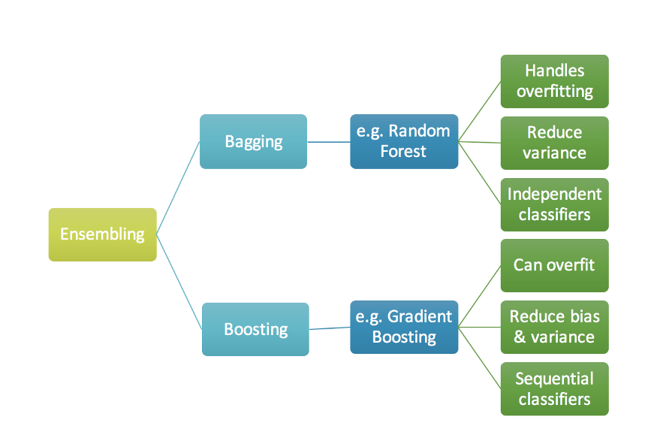
Ensembling

Slide 7
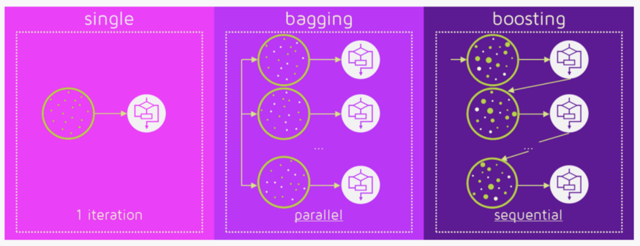
Bagging and Boosting

Slide 8
Gradient Boosting
Gradient boosting is a machine learning technique for regression and classification problems, which produces a prediction model in the form of an ensemble of weak prediction models, typically decision trees.
The objective of any supervised learning algorithm is to define a loss function and minimize it.
Gradient Boosting= Gradient Descent + Boosting

Slide 9
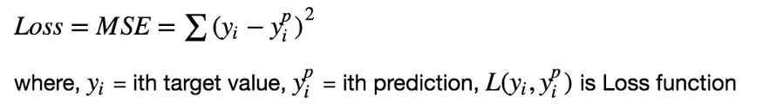
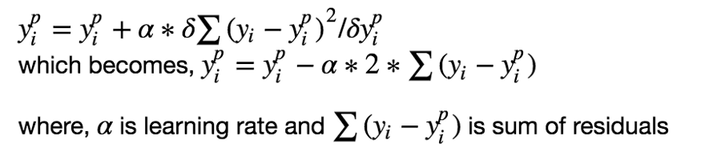
Math Behind Gradient Boosting

Slide 10
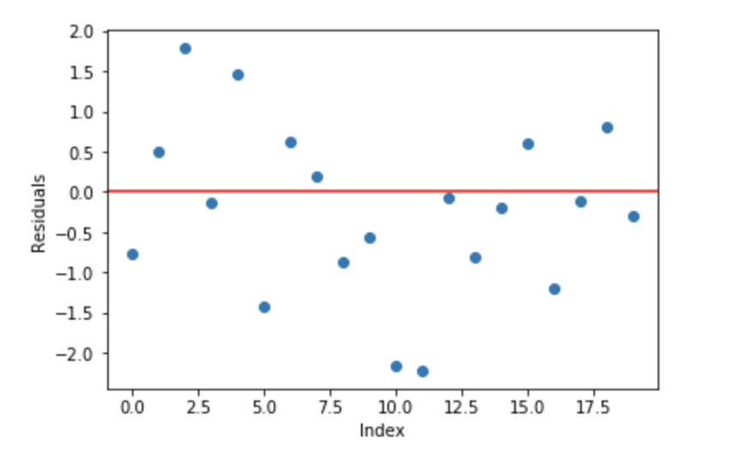
Intuition behind Gradient Boosting
A basic assumption of linear regression is that sum of its residuals is 0, i.e. the residuals should be spread randomly around zero.
Repetitively leverage the patterns in residuals and strengthen a model with weak predictions and make it better.

Slide 11
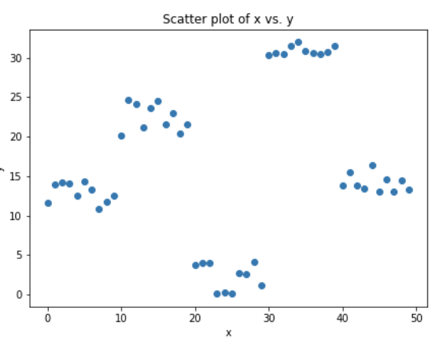
Steps to fit a Gradient Boosting model
Fit a model, let’s say decision tree on data [call x as input and y as output]
Calculate error residuals: e1=y-y_predicted1
Fit a new model on error residuals as target variable with same input variables [call it e1_predicted]
Add the predicted residuals to the previous predictions y_predicted2 = y_predicted1 + e1_predicted
Fit another model on residuals that is still left. i.e. [e2 = y - y_predicted2]and repeat steps 2 to 5 until it starts overfitting, or the sum of residuals become constant.

Slide 12
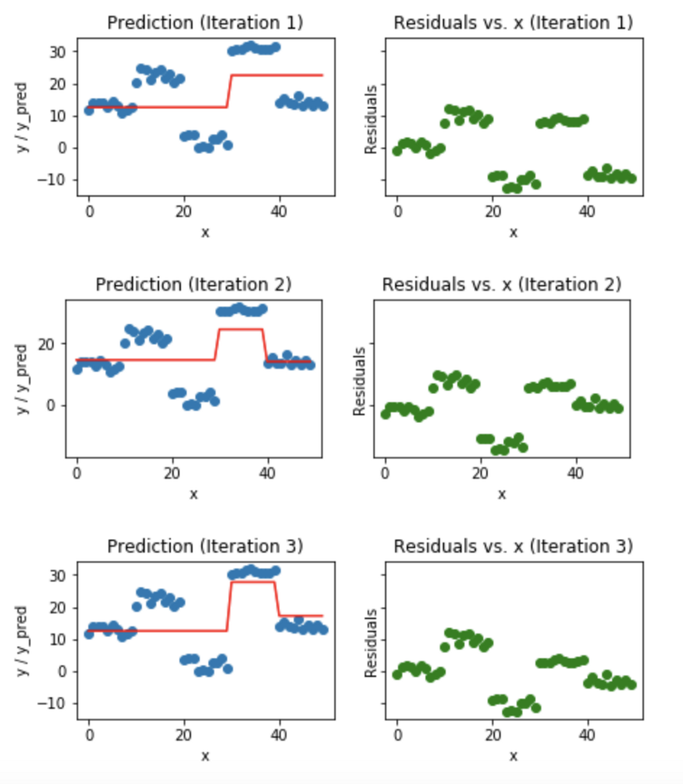
Visualization of working Gradient Boosting Tree

Slide 13
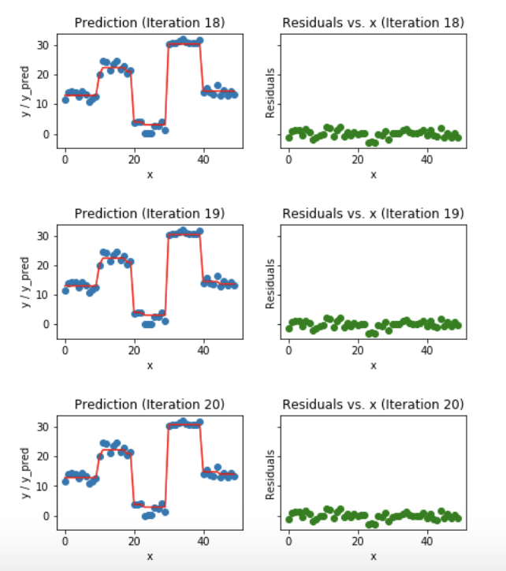
Visualization of working Gradient Boosting Tree

Slide 14
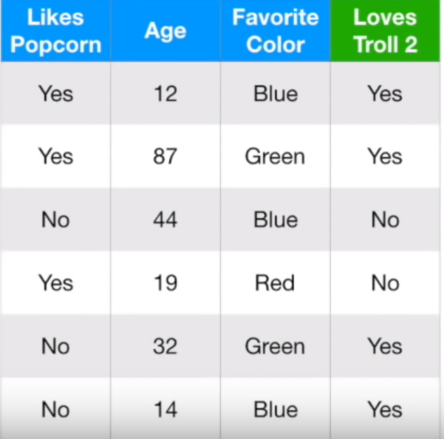
Gradient Boosting For Classification
Initial prediction for every individual is log(odds) who loves Troll 2 is log(4/2) = 0.69(prob of loving troll2)
Convert log(odds) to Probability. i.e, Probability = e^log(odds)/(1+e^log(odds)) = 0.66
We can measure how bad initial prediction is by calculating residuals. Residuals=Observed-Predicted

Slide 15
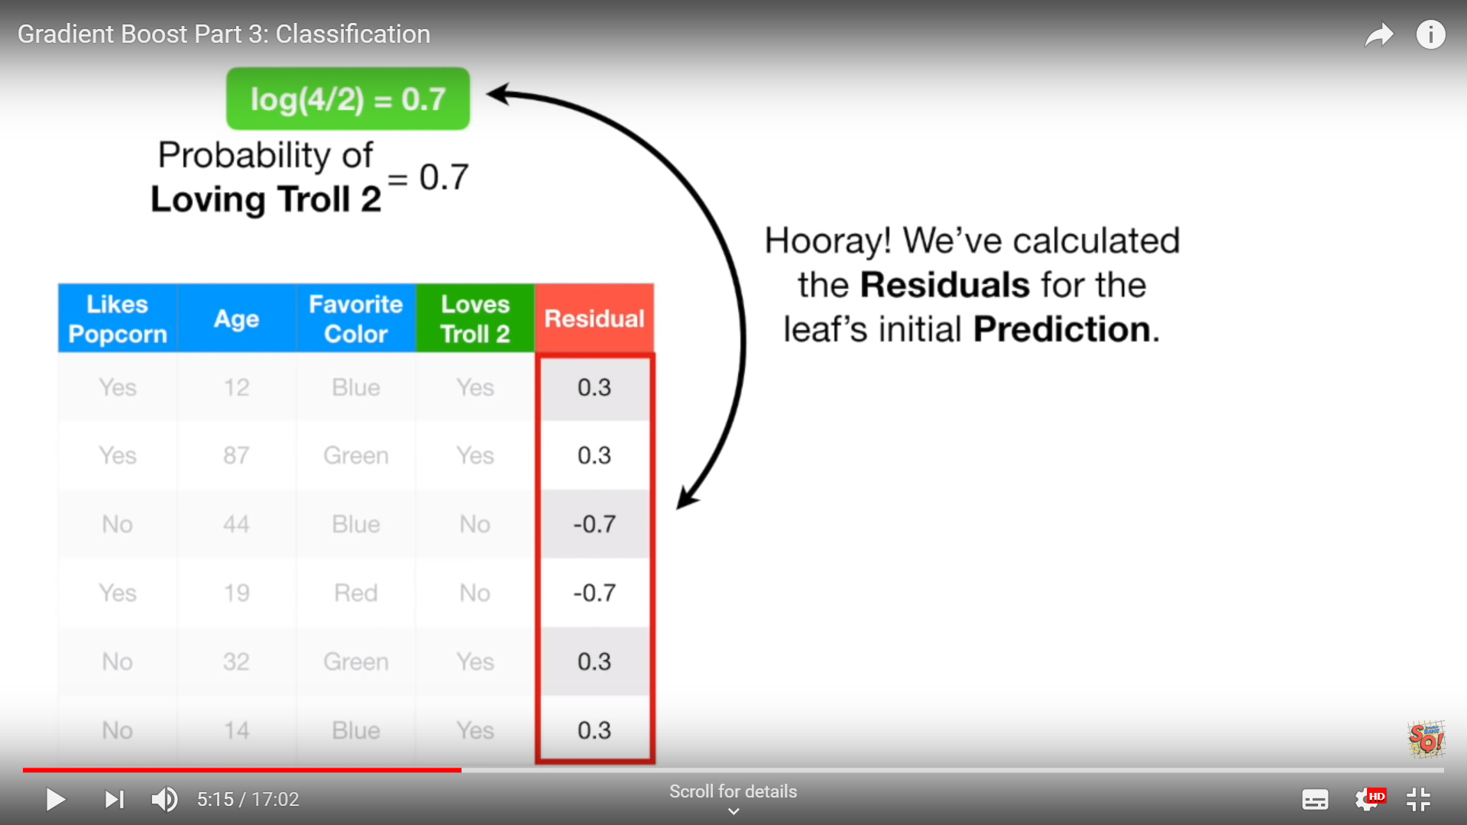
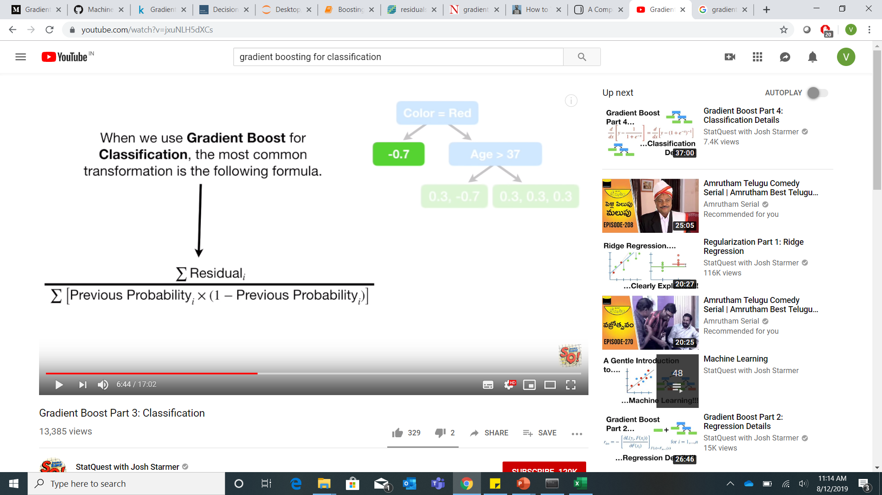
Gradient Boosting For Classification
Now we build a tree of independent variables to predict residuals.
Formula for Transformation:

Slide 16
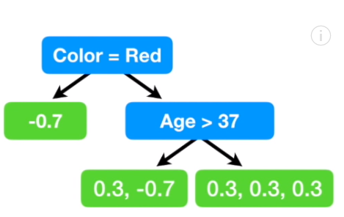
Gradient Boosting For Classification
Here we are limiting number of leaves to 3, but people in general set the values between 8 and 32.
1st Leaf Output = -0.7/(0.7*0.3) = -3.3
2nd Leaf Output = -0.4/2*(0.7*0.3)=-1
3rd Leaf Output = 0.9/3*(0.7*0.3)=1.4
Now update our predictions by combining the initial leaf with new tree

Slide 17
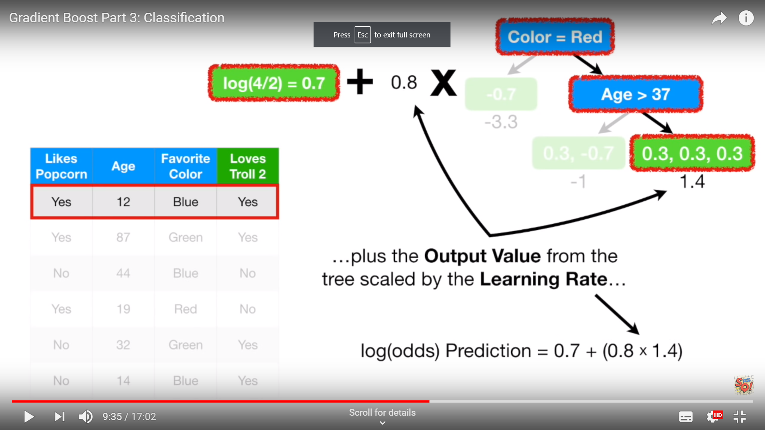
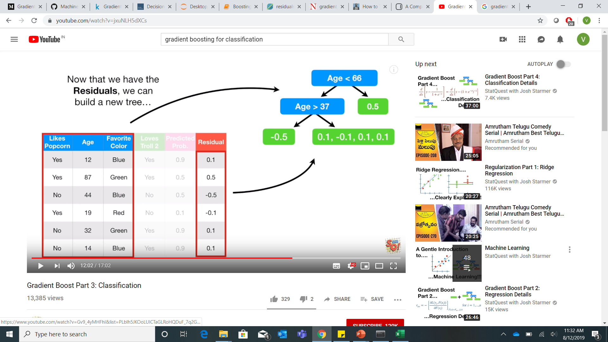
Gradient Boosting For Classification
Log(odds) for first person is 0.7 + (0.8*1.4) = 1.8
Now convert it into prediction
Prediction is e^1.8/(1+e^1.8)=0.9
Add all the trees. This process repeats until we have made the maximum number of trees specified or the residuals get super small.

Slide 18
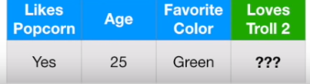
Gradient Boosting For Classification
Logs(Odds) Prediction who loves Troll2 = 0.7 + (0.8*1.4) + (0.8*0.6)=2.3
Probability = e^2.3/(1+e^2.3) = 0.9
Since we are using 0.5 as threshold value. 0.9>0.5
It means, this person loves Troll2.

Slide 19
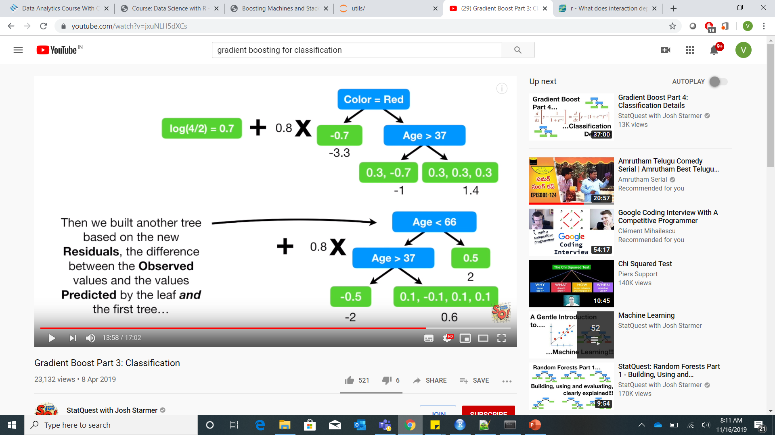
Logs(Odds) Prediction who loves Troll2 =
0.7 + (0.8*1.4) + (0.8*0.6)=2.3
Probability = e^2.3/(1+e^2.3) = 0.9
Since we are using 0.5 as threshold value. 0.9>0.5
It means, this person loves Troll2.

Slide 20
Parameter Tuning
Grid search is an approach to parameter tuning that will methodically build and evaluate a model for each combination of algorithm parameters specified in a grid.
Random search is an approach to parameter tuning that will sample algorithm parameters from a random distribution (i.e. uniform) for a fixed number of iterations. A model is constructed and evaluated for each combination of parameters chosen.
With small data sets and lots of resources, Grid Search will produce accurate results. However, with large data sets, the high dimensions will greatly slow down computation time and be very costly. In this instance, it is advised to use Randomized Search since the number of iterations is explicitly defined by the data scientist.

